Slide 1
Archaeoastronomy
Models of the solar system
The scientific method
Notes:
Video:
Carl Sagan Eratosthenes experiment - https://www.youtube.com/watch?v=G8cbIWMv0rI&feature=emb_logo

Slide 2
Astronomy
A History

Slide 3
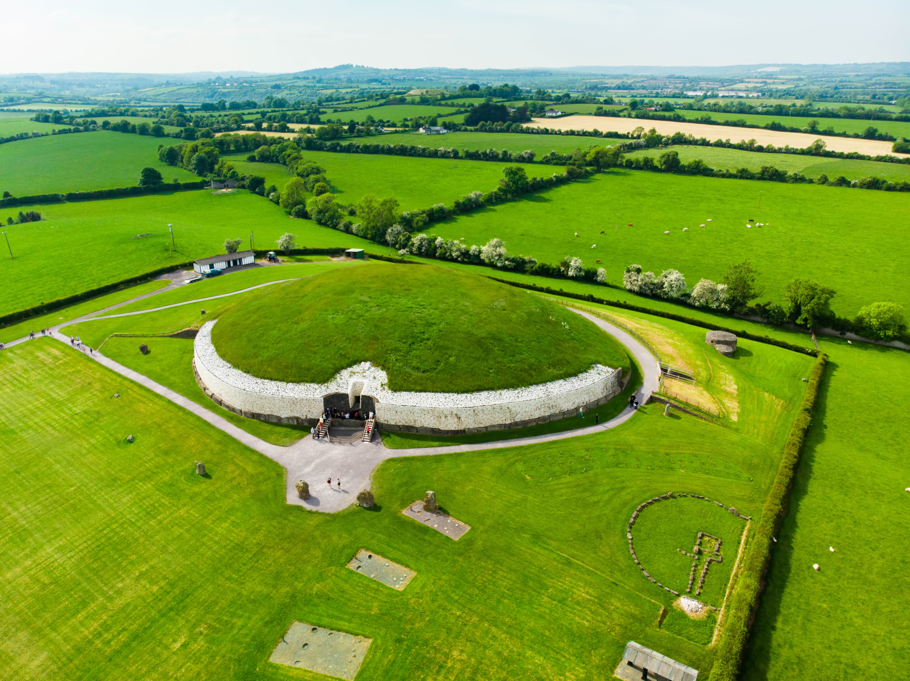
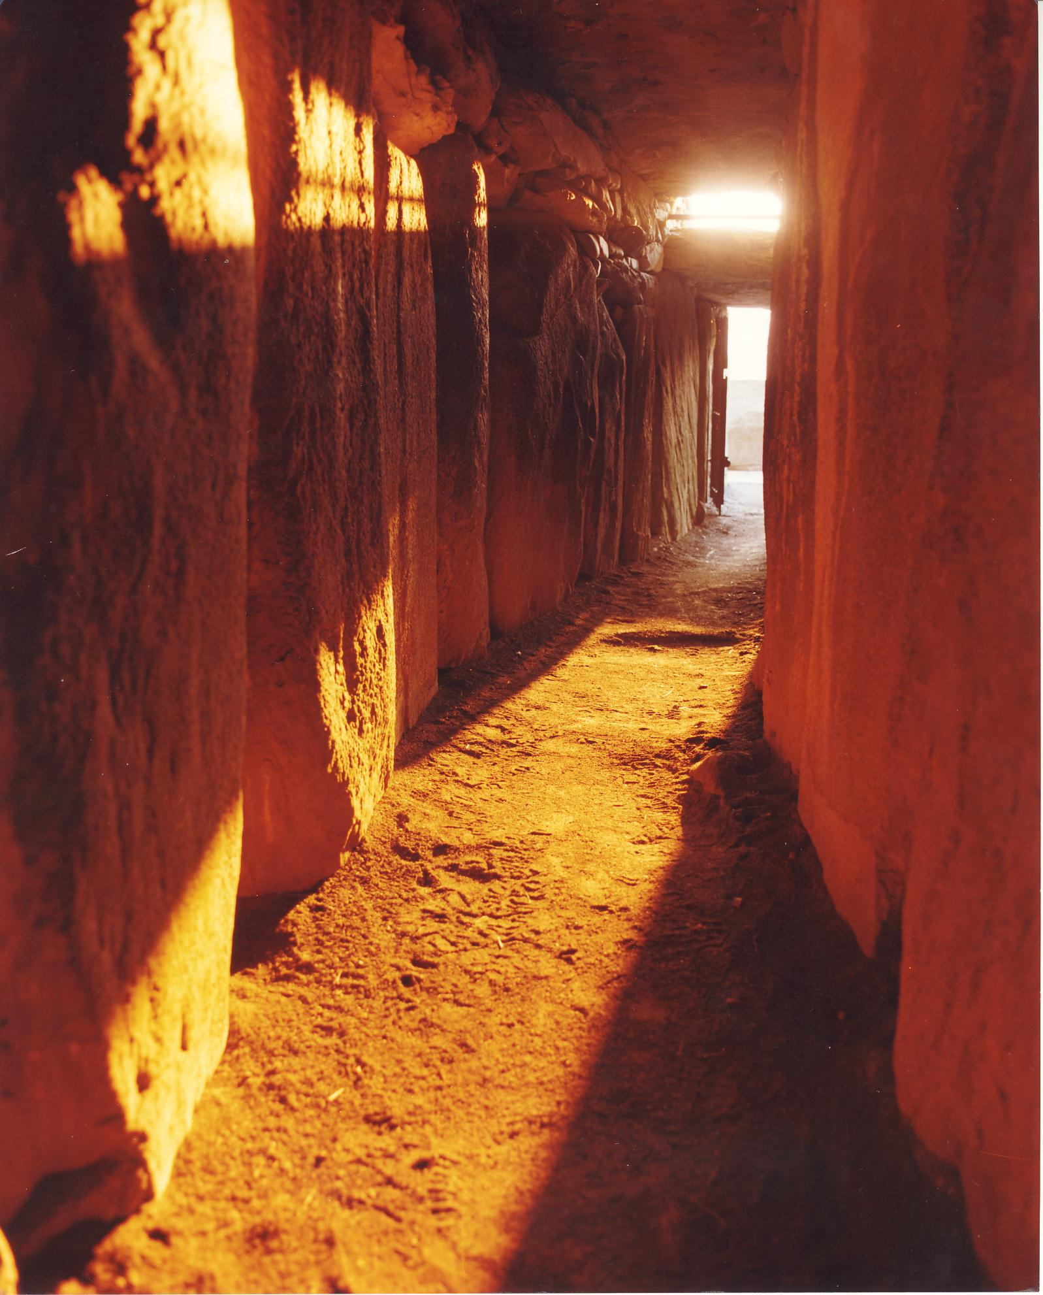
Archaeoastronomy
- The study of how celestial phenomena influenced ancient cultures
National Monuments Division
NMStudio
Notes:
Archaeoastronomy is the study of how celestial events and the night sky influenced primarily ancient cultures.
Here is an image of a Neolithic Tomb in Newgrange, Ireland. Neolithic because it was build at the end of the stone age.
Its entrance contains a door with another opening above it which lets light reach the inner chamber at sunrise near the winter solstice.
Left: NMStudio
Right: National Monuments Division, Office of Public Works, Ireland
National Geographic Video:
https://www.youtube.com/watch?v=KVXWZkwV0RQ

Slide 4
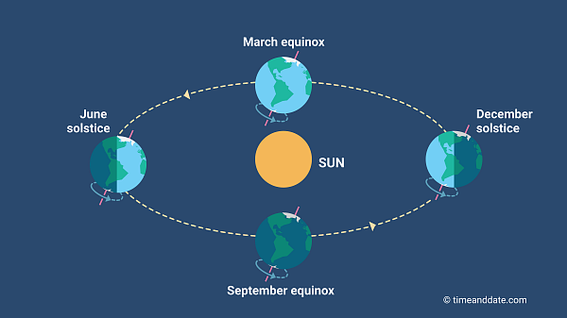
Solstice
The time when the sun is at its highest or lowest point in the sky, giving us the longest (summer) and shortest (winter) days of the year
Notes:
This is the definition of a solstice. There are two every year one in June and one in December. If the northern hemisphere has its summer solstice in June (notice the Earth’s northern hemisphere is tilting towards the sun) then the southern hemisphere has its winter solstice (the southern hemisphere is tilted away from the sun). We’ll look at how this related to seasons in more detail later.

Slide 5
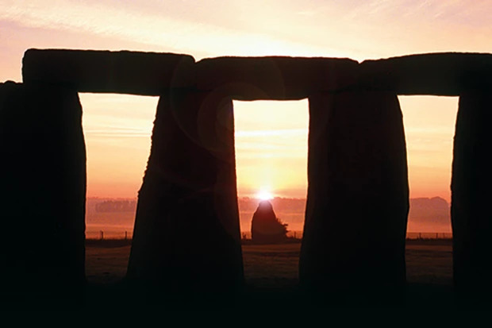
Stonehenge
Galaxy Picture Library / Alamy Stock Photo
Notes:
Stonehenge has had multiple iterations with the earliest elements dating to Mesolithic (pre-Neolithic) times.
Its original axis points towards the rising sun at the summer solstice and the setting sunset at the winter solstice.
Image: Summer solstice sunrise, the sun is touching the top of the Heel Stone (a Menhir or standing stone) seen through the arches of the Dolmen, Galaxy Picture Library / Alamy Stock Photo

Slide 6
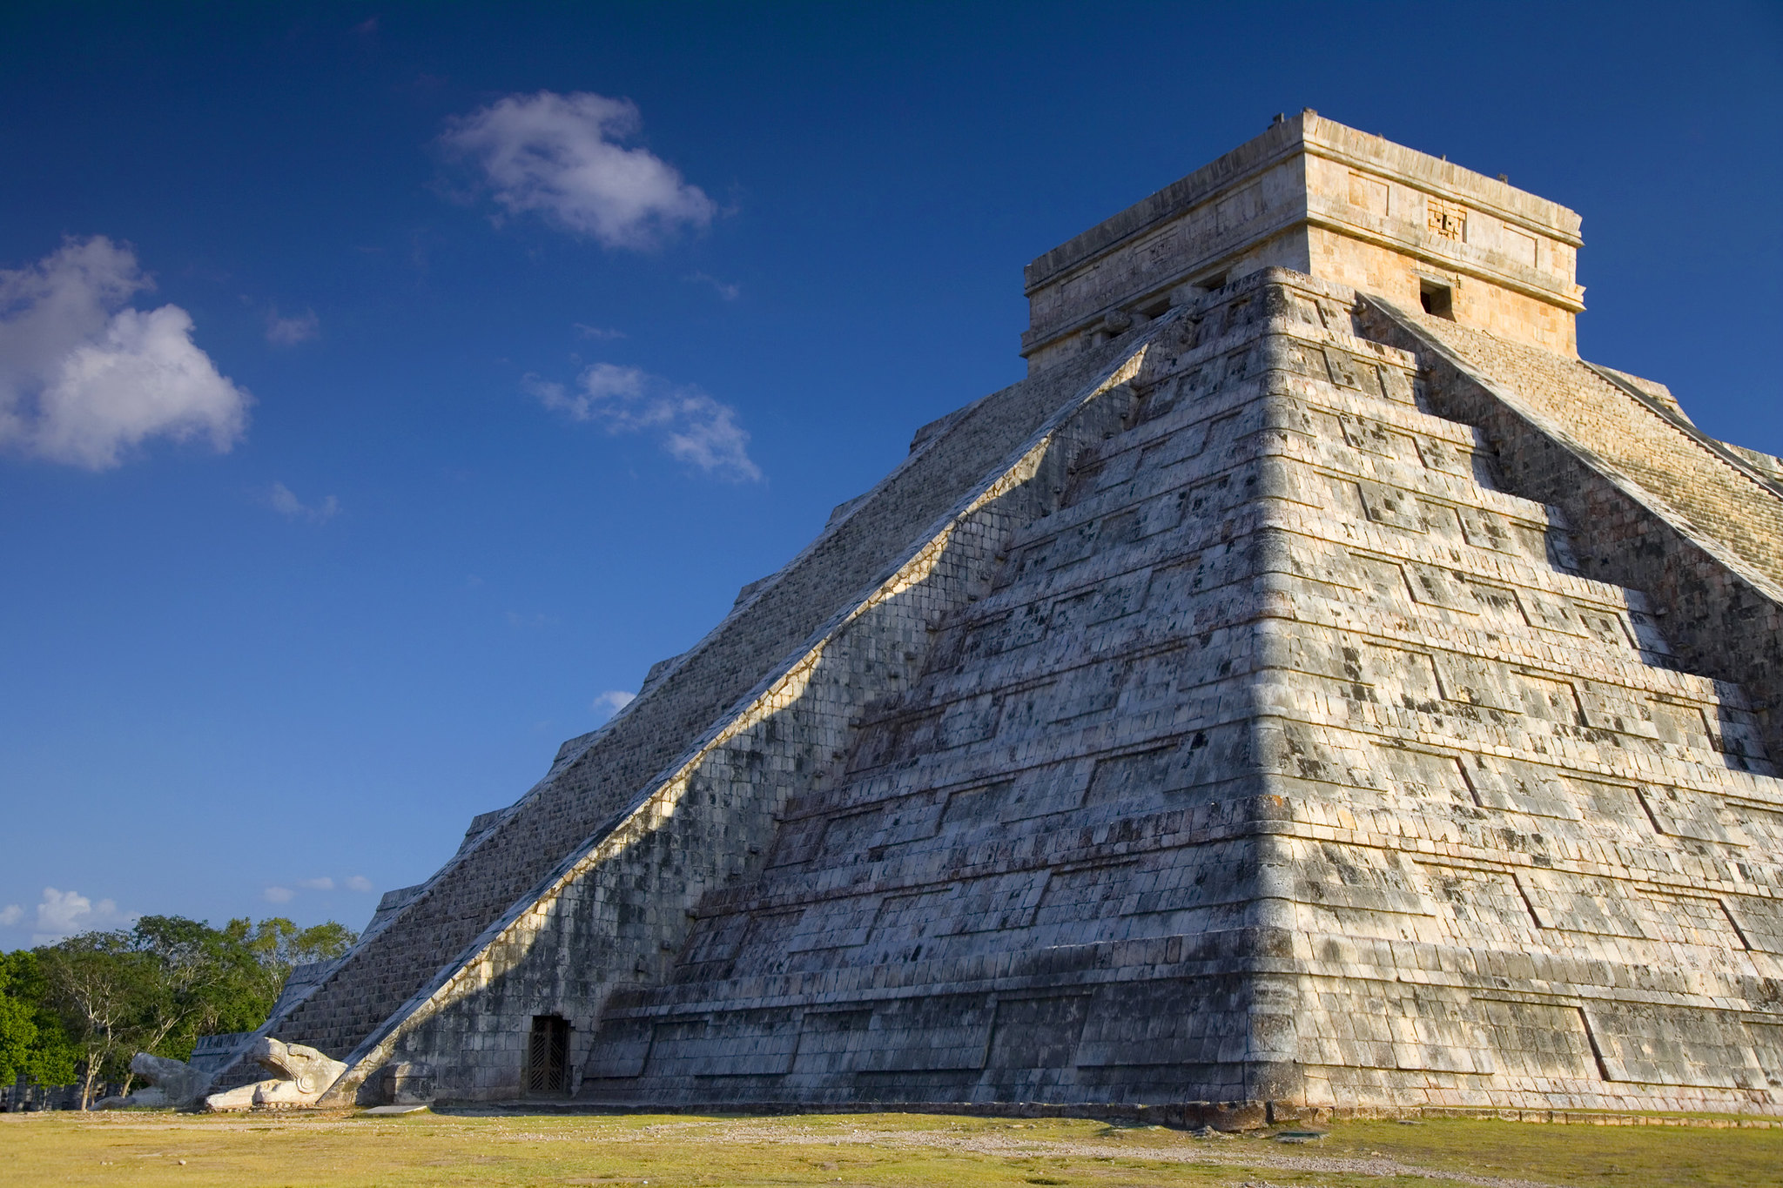
Mayans - Chichén Itzá
Richard Cohen
Notes:
The temple of Chichén Itzá is orientated and built such that on the equinoxes a snake appears to form from the shadow of the temple’s side.
The snake appears to be descending the temple and is a representation of the Mayan god Kukulkan.
Image: Richard Cohen https://www.flickr.com/photos/aboutrichard/5205861649/

Slide 7
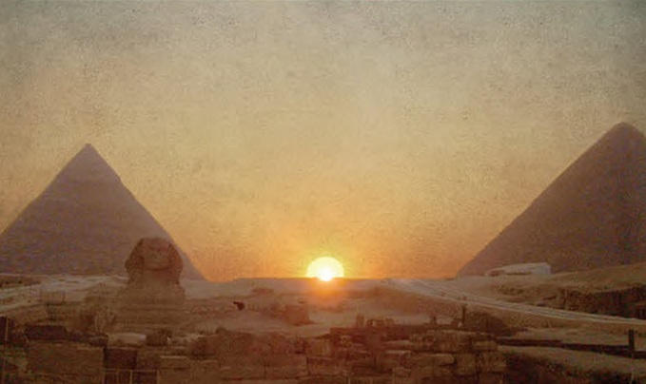
Egypt – Great Pyramids
Guilio Magli – Politecnico di Milano
Notes:
The summer solstice between the Khafra and Khufu pyramids of Giza. The shape formed is the hieroglyph ‘akhet’ which means horizon or rising sun.
The ‘akhet’ hieroglyph is comprised in part by another hieroglyph ‘djew’ which is associated with the afterlife. Of course the pyramids are in fact tombs and Khufu has shafts from the kings burial chamber to the outside night sky which are thought to point to the constellations Sirius and the belt of Orion where gods supposedly came from (remember Pharaohs were considered living gods).
Guilio Magli is an archaeoastronomer at Politecnico di Milano, and has several books and a coursera class on archaeoastronomy.

Slide 8
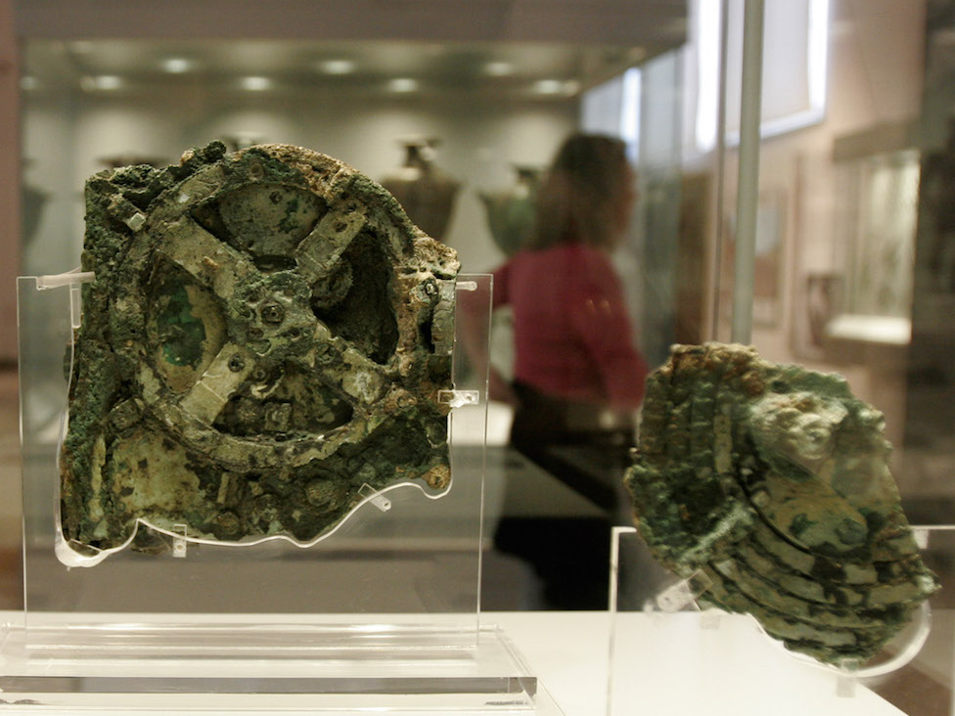
Antikythera mechanism
Thanassis Stavrakis/AP
Notes:
This is an ancient analogue computer using gears developed by ancient Greek scientists to calculate the astronomical positions and timings of eclipses among other events of interest. The image shown is of the main fragment (fragment A) which now resides in the National Archaeological Museum in Athens. There are 82 fragments of the device recovered which have been used to help reconstruct how the device might have worked. The knowledge to make the device was lost until astronomical clocks were made starting in the 11th and 12th centuries CE.
See: http://antikythera-mechanism.gr/

Slide 9
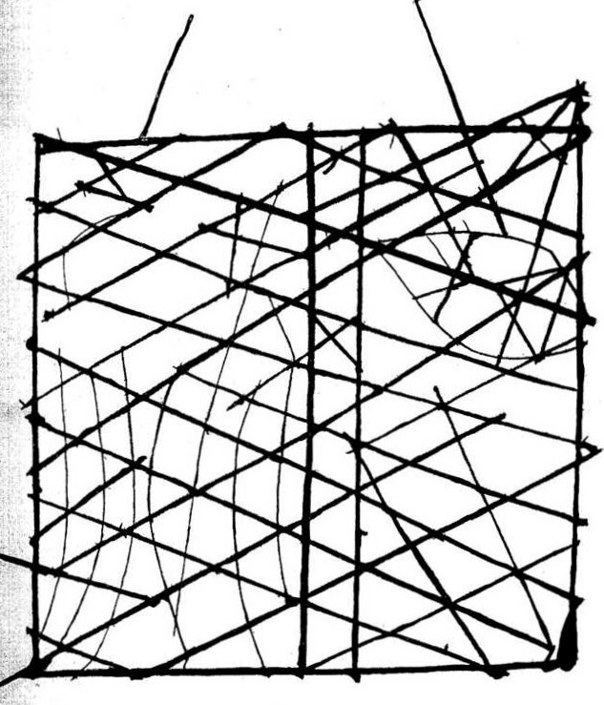
Polynesian Navigation
NZETC
Notes:
Polynesians and possibly Micronesians used navigation devices made out of sticks to show positions of stars, islands, wind, and current directions.
They also had their own ‘star compass’ to help them navigate.
See: https://amedleyofpotpourri.blogspot.com/2018/08/polynesian-navigation.html
Image:
Found here: https://en.wikipedia.org/wiki/Polynesian_navigation#/media/File:Polynesian_navigation_device_showing_directions_of_winds,_waves_and_islands.jpg
Original Source:
http://nzetc.victoria.ac.nz/

Slide 10
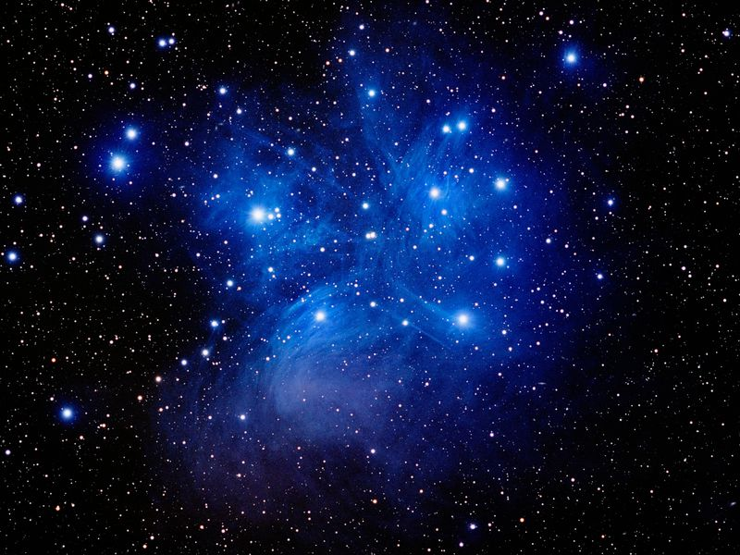
Hawaii - Makahiki
Tony Hallas/Science Faction/Corbis
Notes:
The beginning of the Hawaiian Makahali or ancient New Year festival is timed to coincide with the rise of the star cluster Pleiades (Makali’i) after sunset, usually on the 17th of November.
See: https://apps.ksbe.edu/kaiwakiloumoku/node/601

Slide 11
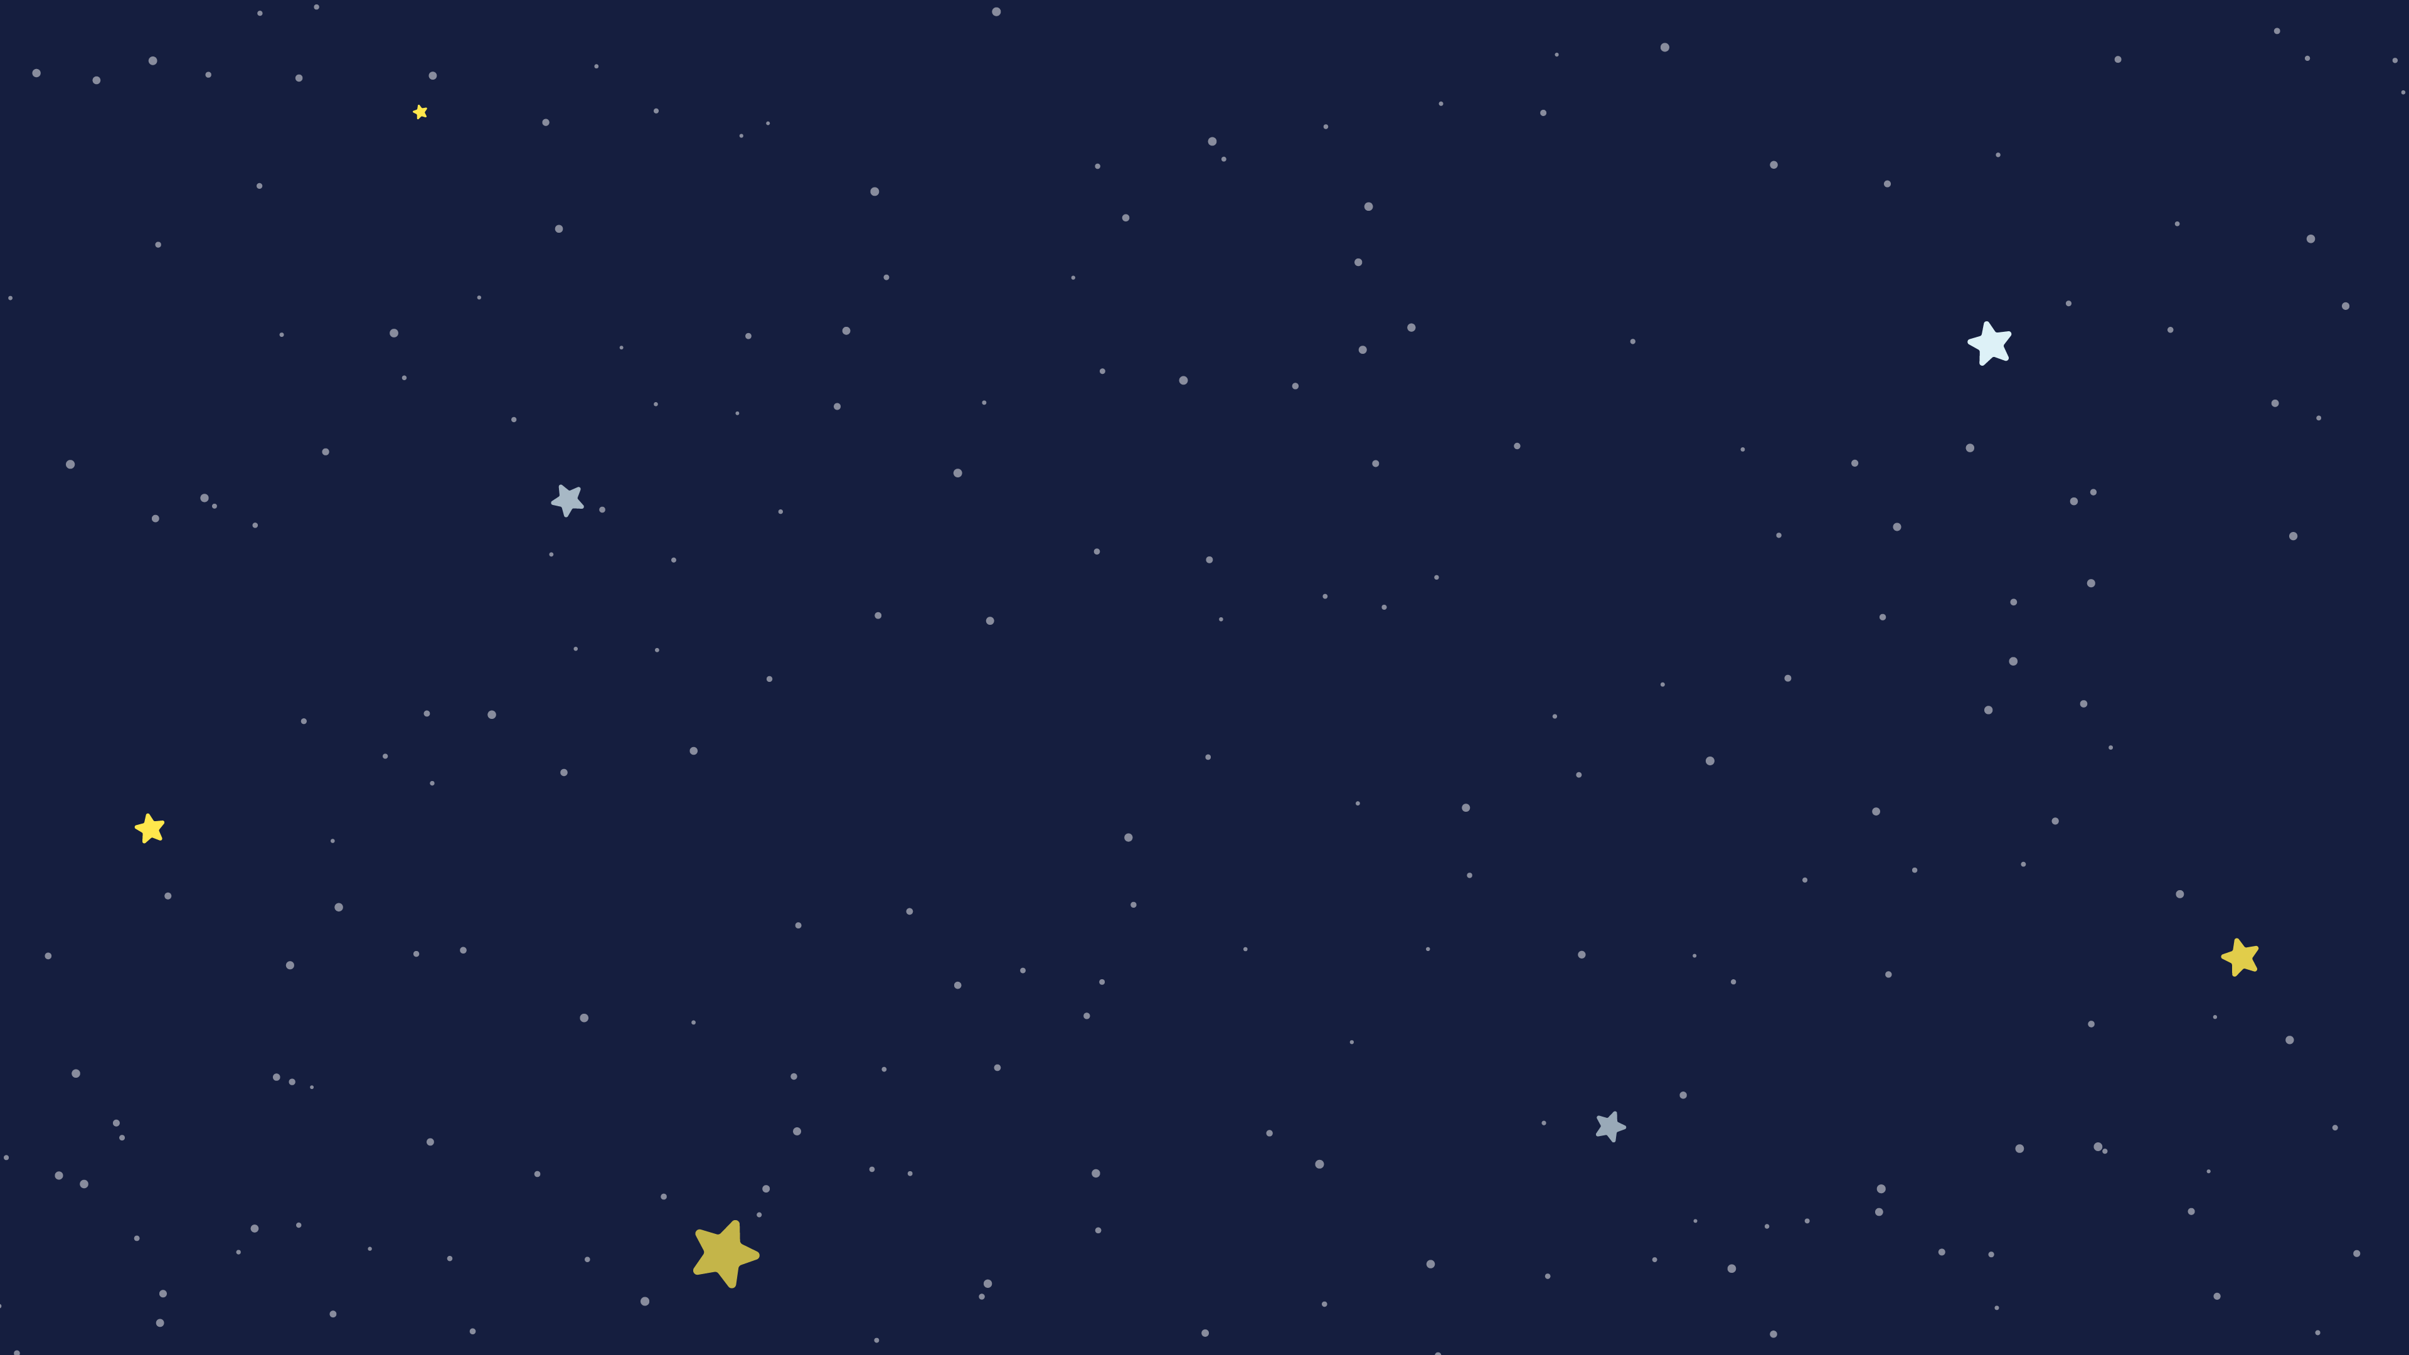
Solar System Models
Each of these famous astronomers/scientists helped improve our model for the solar system by making new observations or taking new data
Ptolemy
Pythagoras
Aristarchus
Copernicus
Tycho
Kepler
Galileo

Slide 12
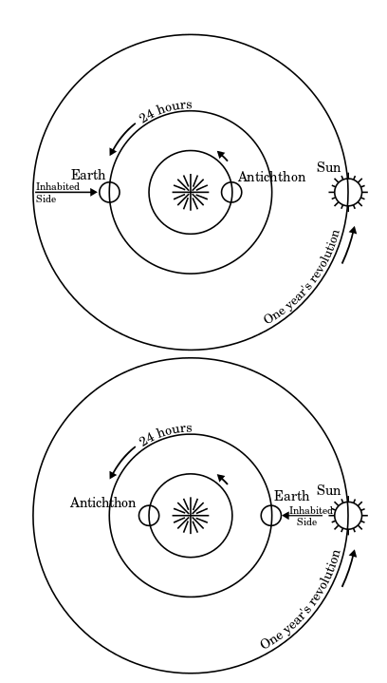
Pythagoras 570 – 495 BCE
Guan-Ze Liao/wikimedia
Notes:
Pythagoras suggested the Earth was not at the center but instead there was a central fire not visible from Earth.
Image: https://en.wikipedia.org/wiki/Pythagorean_astronomical_system#/media/File:Antichthon.svg

Slide 13
Ancient Greeks
Eudoxus (409 – 356 BCE): Model of 27 nested spheres
Aristotle (384 – 322 BCE): Universe can be divided in 2 parts:
1. Imperfect, changeable Earth,
2. Perfect Heavens (described by spheres)
Aristotle expanded Eudoxus’ model to use 55 spheres!
Notes:
Based on Earth is the center of the Universe and the heavens are perfect ie circles

Slide 14
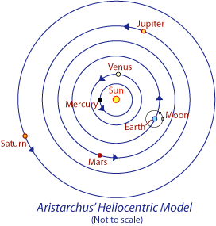
Aristarchus 310 – 230 BCE
Notes:
Aristarchus was the first to suggest a heliocentric or sun-centered model. Although his text describing his theory was lost when the Great Library at Alexandria was destroyed. However Archimedes wrote about Aristarchus’ model in his book ‘The Sand Reckoner’.
Putting the sun at the center of the solar system implies you should observe stellar parallax where foreground (nearer) stars appear to move against background ones in the sky over the course of the year.
In Aristarchus’ time it was not possible to detect this parallax.

Slide 15
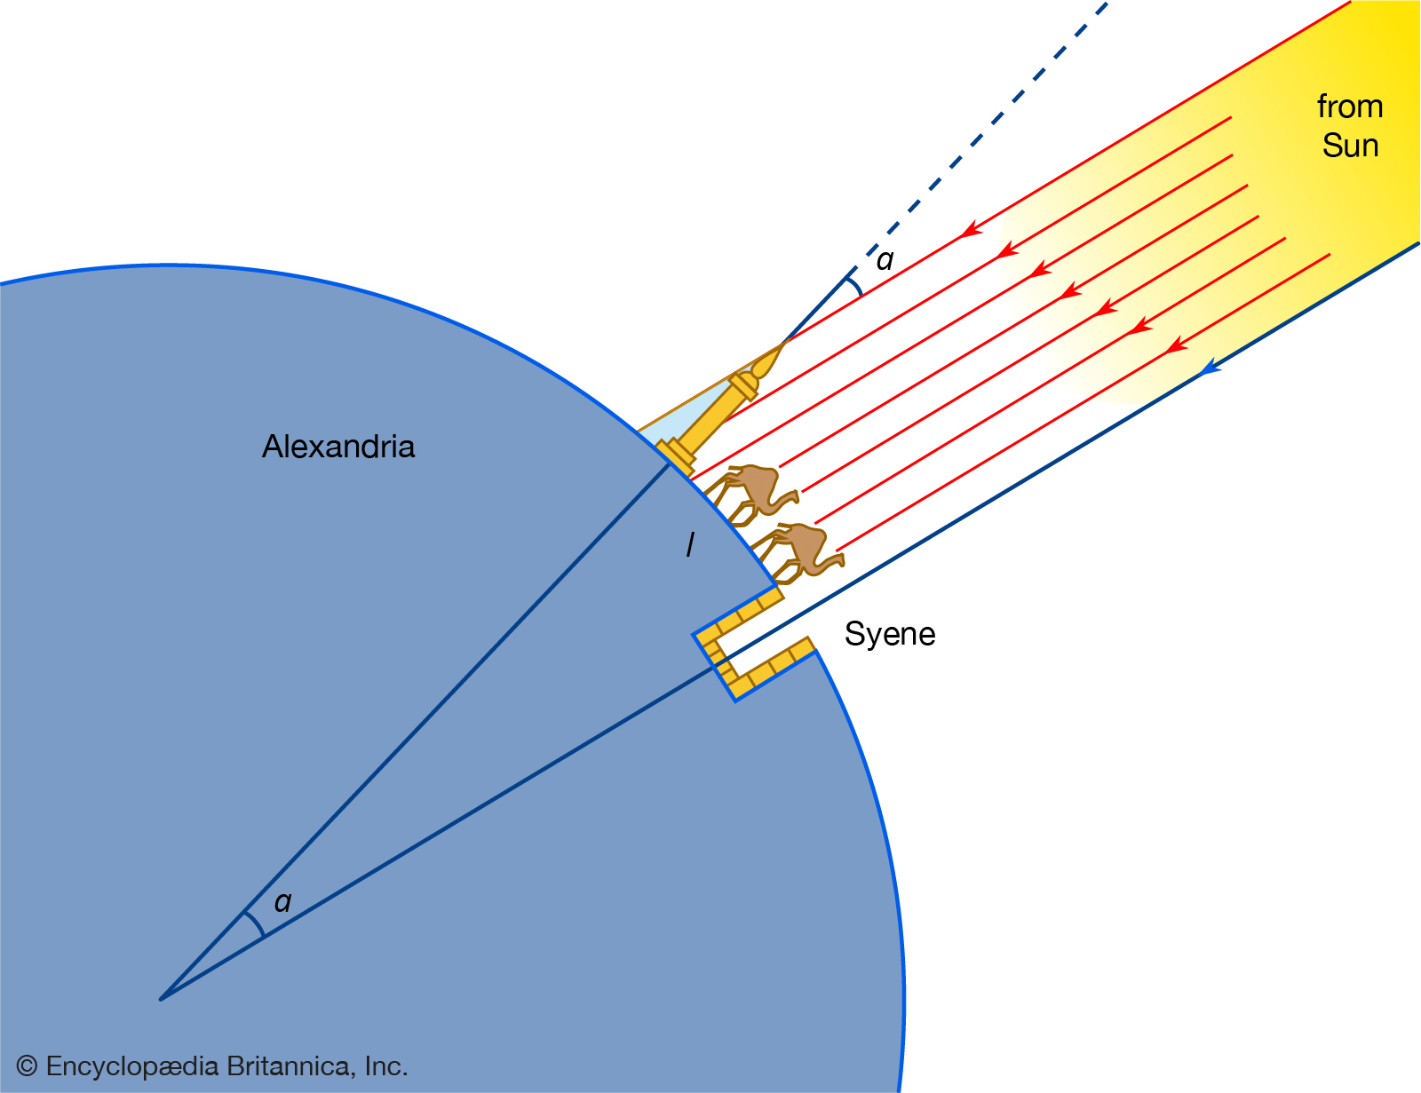
Eratosthenes 276-194 BCE
Angular distance between Syene and Alexandria: ~ 7⁰
Linear distance between Syene and Alexandria: ~ 8,000 km 360⁰/7⁰ = 51.4
8,000 km x 51.4 =
→ Earth Circumference ~ 41,200 km – better than any previous radius estimate.
Actual circumference = 40,075 km
Text: Matthew LeDuc – Weber HS
Notes:
Eratosthenes – didn’t produce a new SS model but managed to measure the circumference of the Earth using basic math and shadows at Alexandria during the summer solstice.
Carl Sagan explains - https://www.youtube.com/watch?v=G8cbIWMv0rI&feature=emb_logo
(great part where he models the shadows with two obelisks)
Explanation by Matthew LeDuc Weber High School Utah

Slide 16
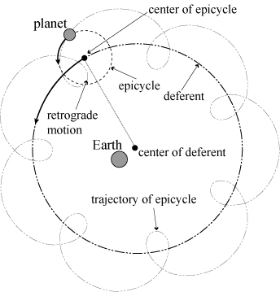
Ptolemy 100 – 170 CE
Guan-Ze Liao
Notes:
The Ptolemy geocentric model. Planets move in circles around circles. Used to explain retrograde motion where a planet moves backwards for a while before moving forwards again. Geocentric means Earth is at the center of the SS (and they believed the Universe).
Image: http://www.mi.sanu.ac.rs/vismath/liao/introduction.html

Slide 17
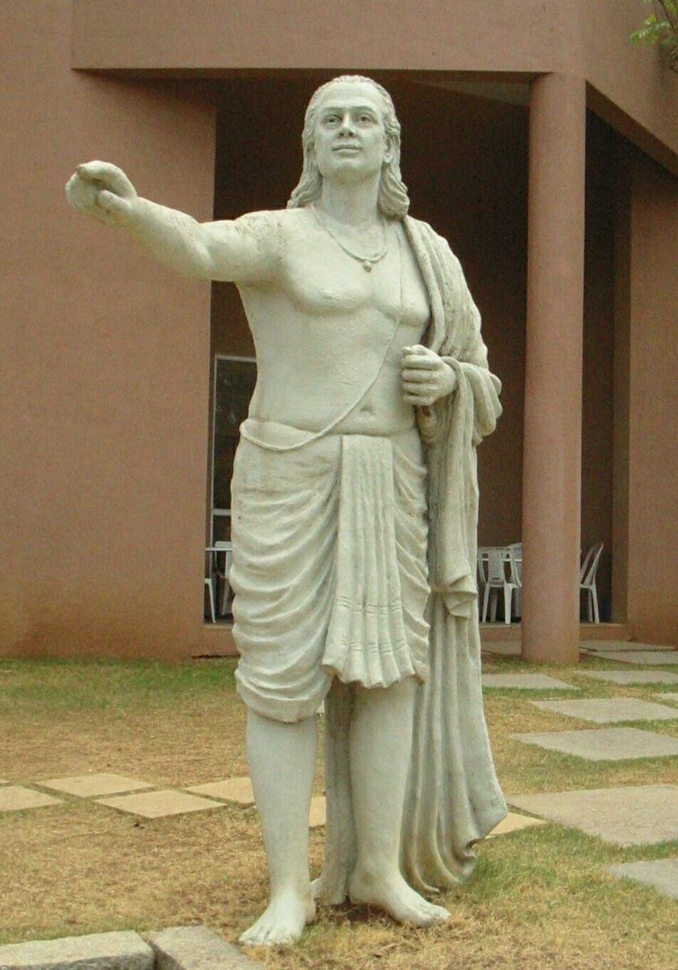
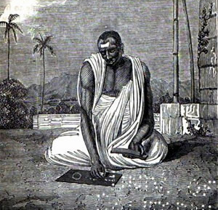
Indian Astronomy
Āryabhaṭa (476 - 550 CE)
believed that the planets and the Moon shine by reflected sunlight
proposed the motion of the stars is due to Earth's rotation
Islamic, Chinese, and European astronomy is based on this work
Brahmagupta (598 - 668 CE)
calculated the instantaneous motion of a planet
gave correct equations for parallax
theorized that all bodies with mass are attracted to the earth
Text: Matthew LeDuc – Weber HS – Top Image: Uncredited, Bottom Image: Frans B Solvyns
Notes:
Eratosthenes – didn’t produce a new SS model but managed to measure the circumference of the Earth using basic math and shadows at Alexandria during the summer solstice.
Carl Sagan explains - https://www.youtube.com/watch?v=G8cbIWMv0rI&feature=emb_logo
(great part where he models the shadows with two obelisks)
Explanation by Matthew LeDuc Weber High School Utah
Bottom image: 19th-century illustration of a Hindu astronomer. Original caption: "Dybuck, an astronomer, calculating an Eclipse." The illustration, as well as the term dybuck, is derived from an etching with the title "Daybouk ou astronome hindou" by Frans Balthazar Solvyns (between 1791 and 1803), published in his Les Hindous (1808) (from Wikipedia)

Slide 18
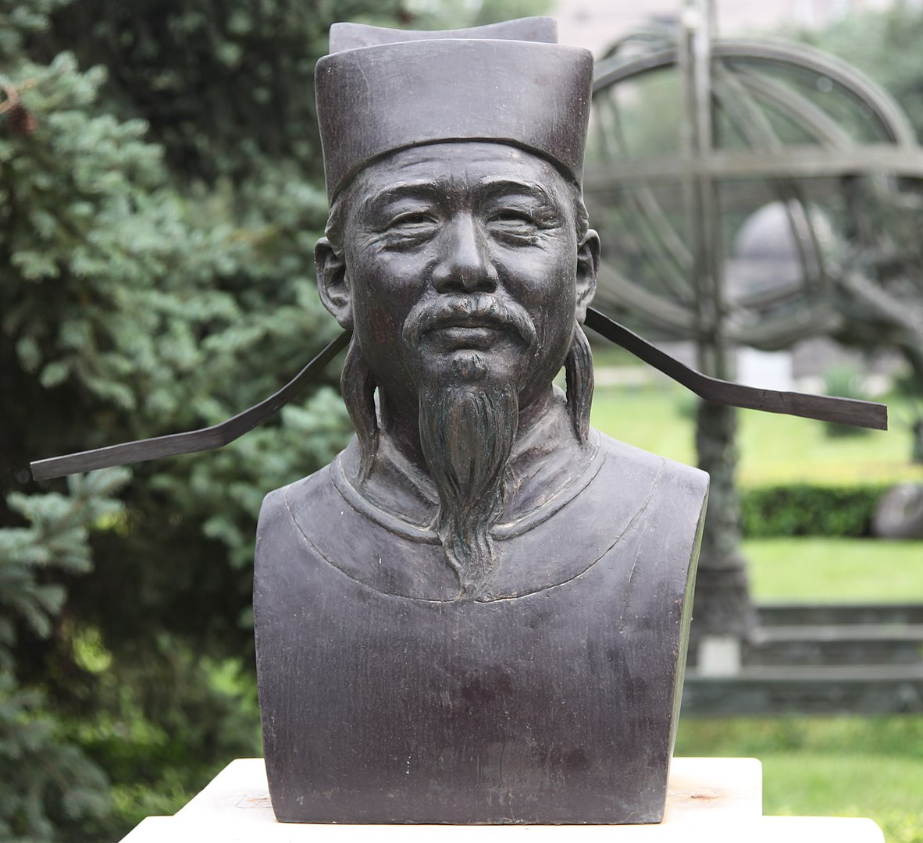
Chinese Astronomy
Were considered the most persistent and accurate observers of celestial phenomena anywhere in the world before the Islamic astronomers
Shi Shen (4th century BCE) was aware of the relation of the moon in a solar eclipse
Xuan Ye school (~280 CE)
viewed the heavens as infinite in extent
celestial bodies as floating about in the infinite
Shen Kuo (1031–1095 CE) used the models of lunar eclipse and solar eclipse in order to prove that the celestial bodies were round, not flat
Text: Matthew LeDuc – Weber HS – Image: Shen Kuo bust by Hans A. Rosbach

Slide 19
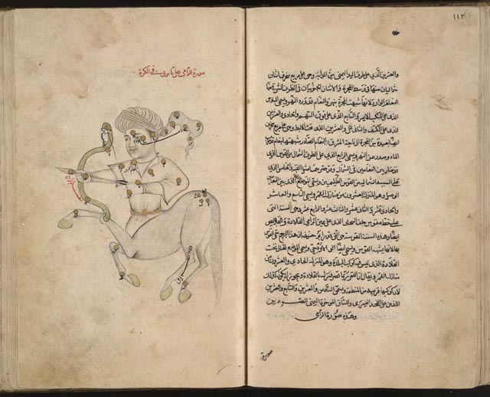
Islamic Astronomy
Muslim scholars developed spherical trigonometry and algebra
Abd al-Rahman al-Sufi (904-986 CE)
Book of Fixed Stars
First to record observing the Andromeda galaxy and the Large Magellanic Cloud
Nasir al-Din al-Tusi (1201-1274 CE)
Tusi couple
Explains the apparent linear motion of heavenly bodies on the basis of circular motion
Text: Matthew LeDuc – Weber HS – Image: The constellation Sagittarius from The Depiction of Celestial Constellations

Slide 20
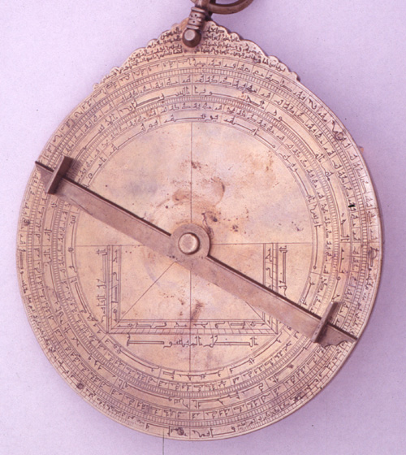
Islamic Astronomy
Ibn al-Haytham (965-1040 CE)
the “father of optics”
his work developed camera obscura
his work aided in development of telescopes
started the foundations of the scientific method
Many schools and mosques that taught math and astronomy were overseen by Muslim women
Mariam al-Astrulabi (mid 900s CE Syrian female)
perfected the making of astrolabes
used to calculate altitude of celestial bodies in the sky
Text: Matthew LeDuc – Weber HS – Image: Arabic astrolabe, Katie Eagleton and the Whipple Museum

Slide 21
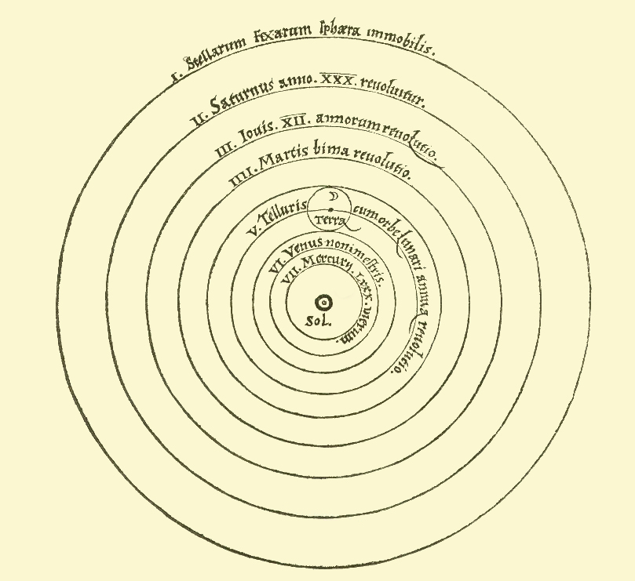
Copernicus 1473 – 1542 CE
Nicolaus Copernicus
Notes:
The Copernican model of the solar system from his the work De revolutionibus orbium coelestium (On the Revolutions of Heavenly Spheres) 1543.
He introduced 4 new ideas:
1) The Earth is one of several planets revolving around a stationary sun in a determined order.
2) The Earth has three motions: daily rotation, annual revolution, and annual tilting of its axis.
3) Retrograde motion of the planets is explained by the Earth's motion.
4) The distance from the Earth to the Sun is small compared to the distance from the Sun to the stars.
See: https://en.wikipedia.org/wiki/Copernican_heliocentrism

Slide 22
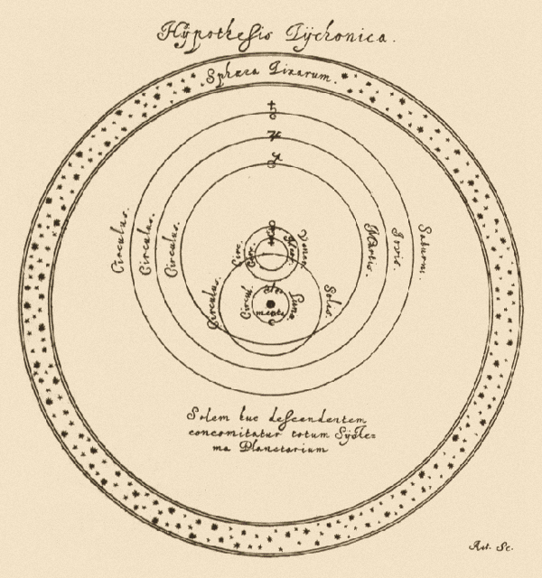
Tycho 1546 – 1601 CE
Tycho Brahe
Notes:
Tycho Brahe’s model had the Earth at the center with the moon and the stars around the Earth. The sun then orbited the Earth and the planets orbited the sun.
He came up with this model in part because he couldn’t measure stellar parallax so thought the Copernian model to be false.
Image of the Hypothesis Tychonica from Hevelius’ Selenographia 1647 page 163.
See: https://en.wikipedia.org/wiki/Tychonic_system#/media/File:Tychonian.png

Slide 23
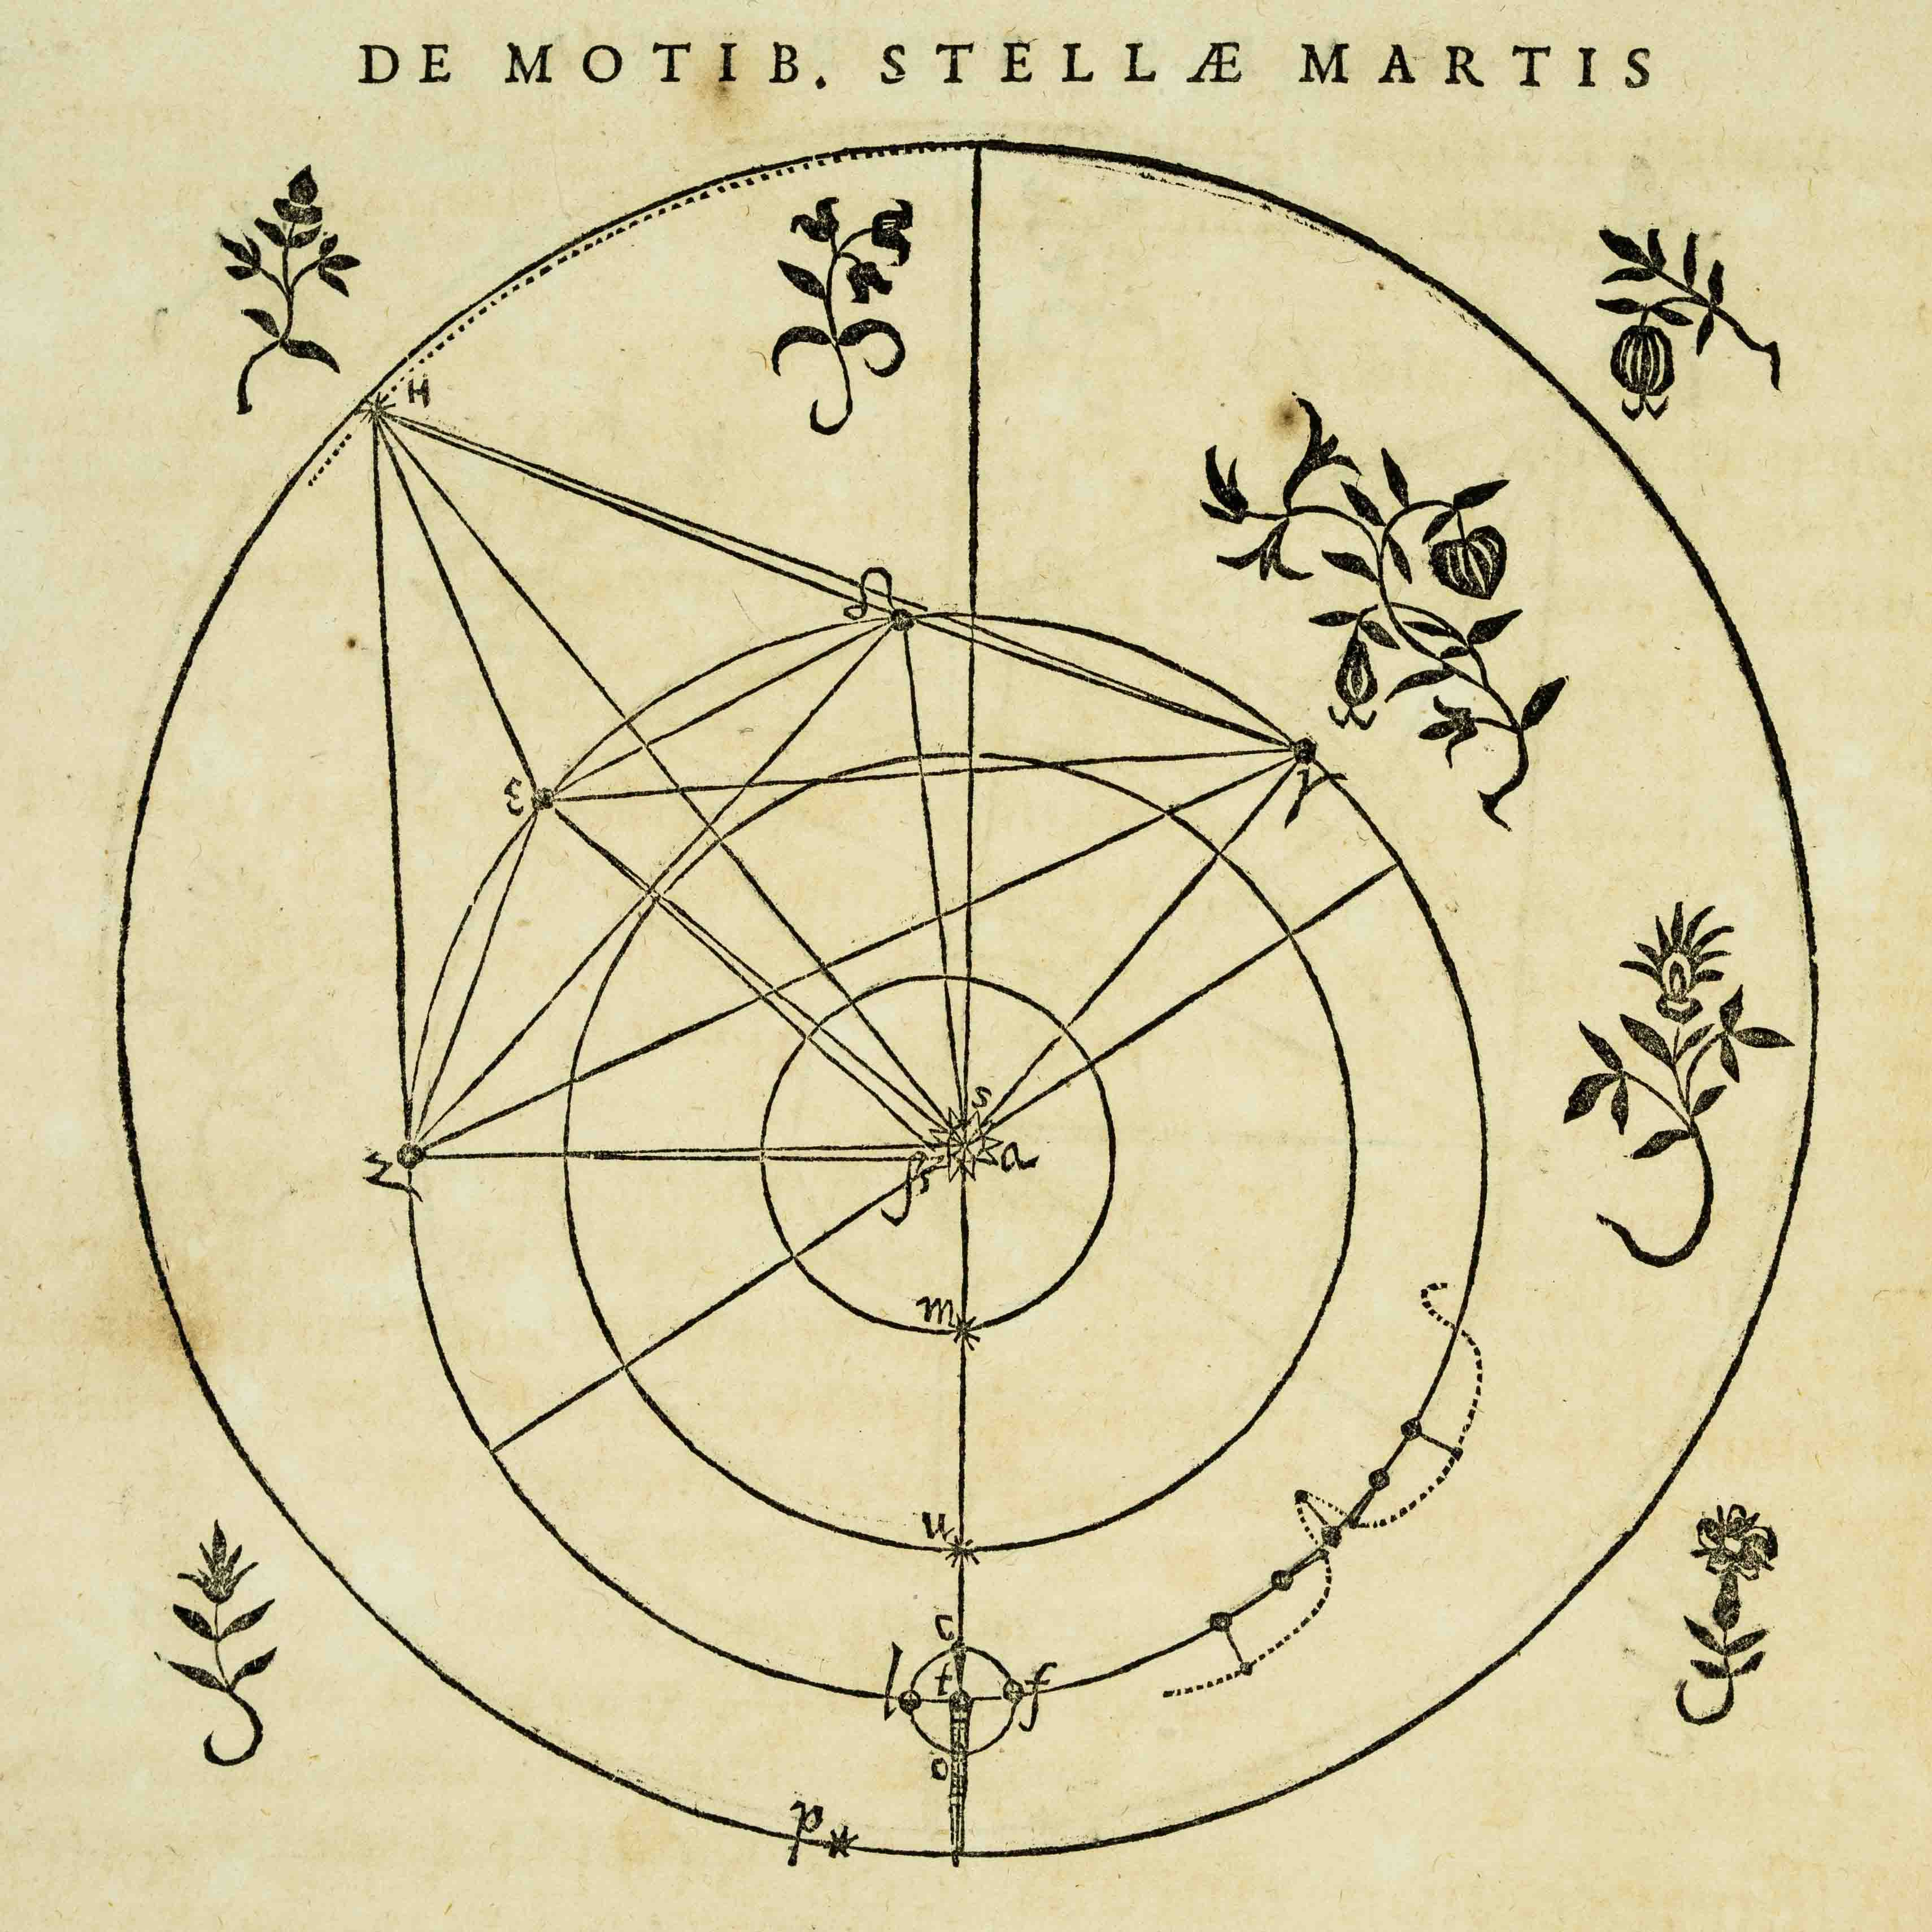
Kepler 1571 – 1630 CE
Sean Wilkinson
Notes:
Johannes Kepler worked for a period with Tycho Brahe and took over his work when he died. In his work Astronomia Nova he fit observations of Mars to an elliptical orbit not circular.
This illustration from Astronomia Nova shows the inner solar system.
Image from: https://ecommons.udayton.edu/rosebk_images/83/

Slide 24
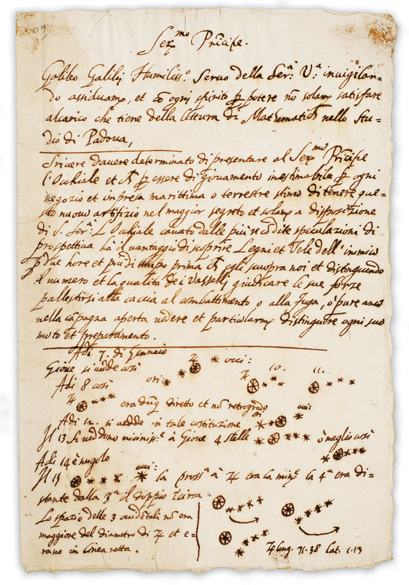
Galileo 1594 – 1642 CE
University of Michigan
Notes:
A draft letter from Galileo to Leonardo Donato, Doge of Venice in 1609 showing Galileos observations of the Galilean Moons of Jupiter.
Galileo observed craters on the Moon and sunspots on the Sun with his telescopes. He also concluded that some supernova were far enough away that they would not show parallax.
His ideas and observations laid the foundation of modern astronomy.
See: https://www.lib.umich.edu/special-collections-research-center/galileo-manuscript

Slide 25
The Heliocentric Model
Galileo's observations of the phases of Venus and the Galilean moons of Jupiter proved that not everything orbits the Earth
His observations of sunspots and lunar craters proved the heaven was not perfect
He suggested that we couldn’t measure stellar parallax yet and that some stars are so distance they have no parallax
Galileo showed that we can move with the motion of the Earth around the sun (as can the moon) without being left behind as Earth moved in its orbit by formulating an early version of Newton’s first law of motion
How does this evolution follow the Scientific Method?

Slide 26
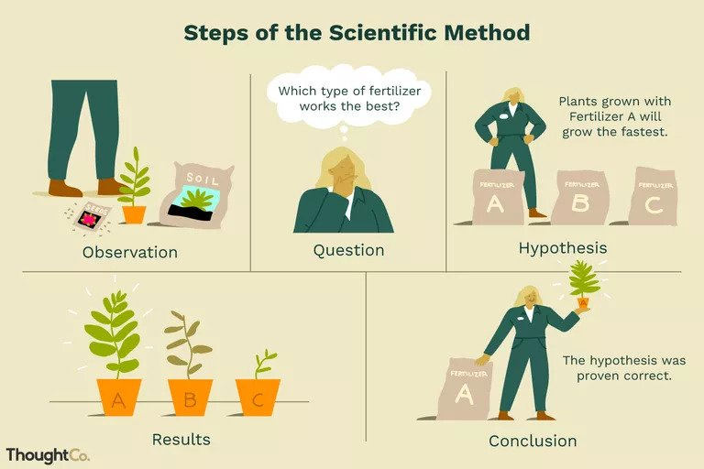
PEER REVIEW!
Notes:
ThoughtCo Article on the Scientific method:
https://www.thoughtco.com/scientific-method-p2-373335

Slide 27
Solar System Structure
Up next:

